Slide 1
Alzheimer’s Association Resources for Support

Slide 2
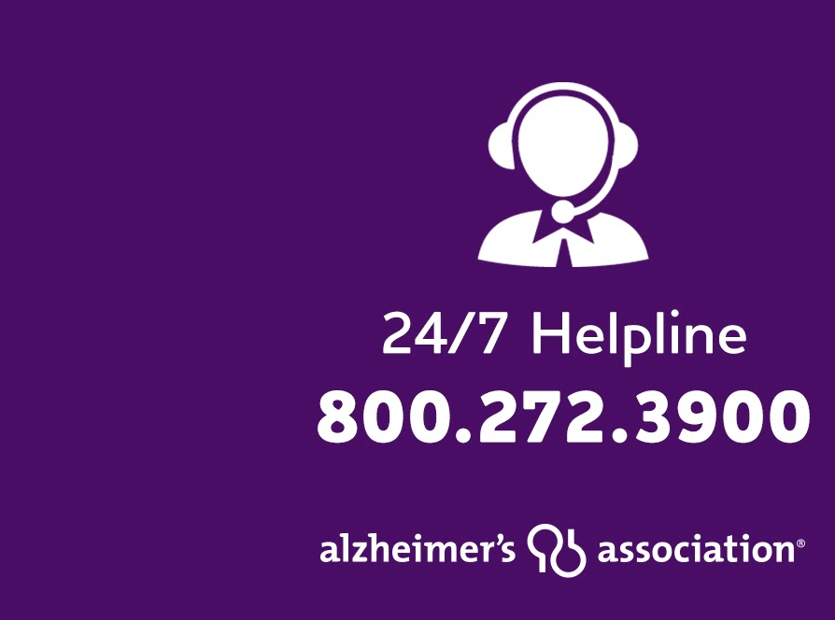
Alzheimer’s Association 24/7 Helpline
Available around the clock, 365 days a year.
Helpline specialists and master’s-level clinicians offer confidential support and information.
Bilingual staff and translation service in 200+ languages
Live chat available.
TTY Service 866.403.3073
Notes:
The Alzheimer’s Association 24/7 Helpline (800.272.3900) is available around the clock, 365 days a year. Through this free service, specialists and master’s-level clinicians offer confidential support and information to people living with the disease, caregivers, families and the public. You can also receive a personalized phone or virtual Care Consultation to help you design a plan by calling our 24/7 Helpline at 800-272-3900. There you can talk to a social worker about your family’s unique needs and how to support the person you’re caring for.
Call the 24/7 Helpline day or night to:
Speak confidentially with master’s-level care consultants for decision-making support, crisis assistance and education on issues families face every day.
Learn about the symptoms of Alzheimer’s and other dementias.
Find out about local programs and services.
Get general information about legal, financial and care decisions, as well as treatment options for managing symptoms.
Receive help in your preferred language through our bilingual staff or translation service, which accommodates more than 200 languages.
Access support through our TTY service (TTY: 866.403.3073) if assistance is required via a teletype device.
THANK YOU ALL FOR ATTENDING AND GOODNIGHT AND TAKE CARE!

Slide 3
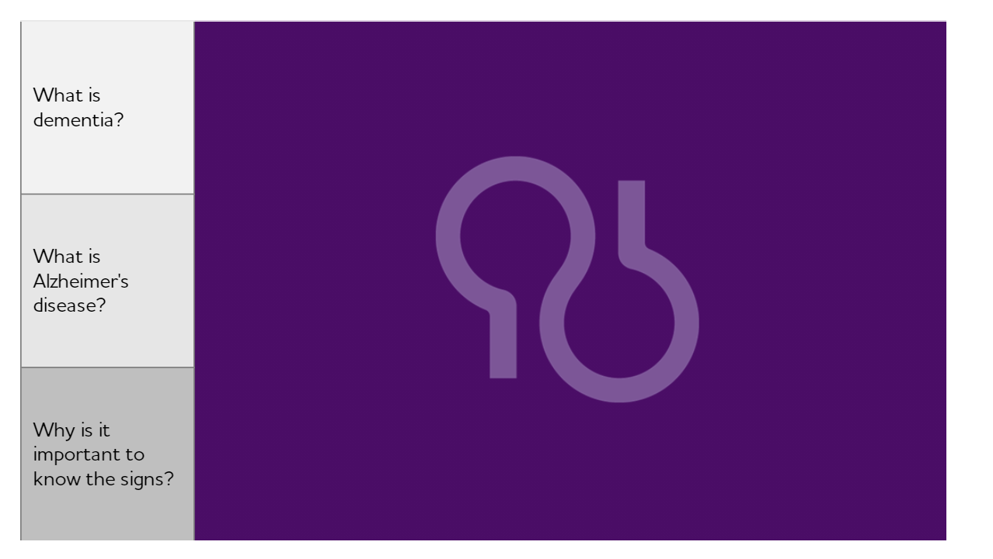
Alzheimer’s Association Resources
www.ALZ.org/nca, National Capital Area chapter
Broad range of caregiver support group meetings and memory café meetings in the Maryland, Washington, DC, Northern Virginia area
Education programs in English, Spanish and Mandarin, virtual and in-person
Notes:
The Alzheimer’s Association 24/7 Helpline (800.272.3900) is available around the clock, 365 days a year. Through this free service, specialists and master’s-level clinicians offer confidential support and information to people living with the disease, caregivers, families and the public. You can also receive a personalized phone or virtual Care Consultation to help you design a plan by calling our 24/7 Helpline at 800-272-3900. There you can talk to a social worker about your family’s unique needs and how to support the person you’re caring for.
Call the 24/7 Helpline day or night to:
Speak confidentially with master’s-level care consultants for decision-making support, crisis assistance and education on issues families face every day.
Learn about the symptoms of Alzheimer’s and other dementias.
Find out about local programs and services.
Get general information about legal, financial and care decisions, as well as treatment options for managing symptoms.
Receive help in your preferred language through our bilingual staff or translation service, which accommodates more than 200 languages.
Access support through our TTY service (TTY: 866.403.3073) if assistance is required via a teletype device.
THANK YOU ALL FOR ATTENDING AND GOODNIGHT AND TAKE CARE!

